Slide 1
Improving Modern Techniques of Causal Inference: Finite Sample Performance of ATM and ATO Doubly Robust Estimators, Variance Estimation for ATO Estimators, and Contextualized Tipping Point Sensitivity Analyses for Unmeasured Confounding
Lucy D’Agostino McGowan

Slide 2
Exploring finite-sample bias in propensity score weighting choices

Slide 3

Observational Studies
exposure
outcome

Slide 4
Observational Studies
Randomized Controlled Trials
Treatment
P=0.5
Control
P=0.5

Slide 5
Observational Studies
Treatment
P=0.9
Control
P=0.1

Slide 6
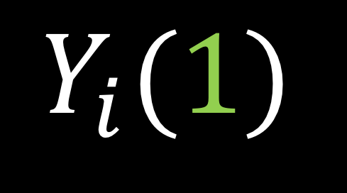

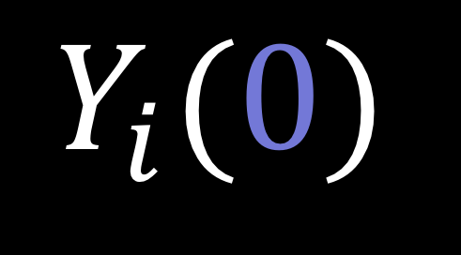
Potential outcomes
$$Y_{i}(0)$$
$$Y_{i}(1)$$
$$−$$
Notes:
In a study such as this, there are two potential outcomes for an individual I, Y i 0, the outcome if they are assigned the control and Y i 1, the outcome if they are assigned the treatment. Often our estimate of interest is the difference between these two outcomes. In reality, however only one of these two quantities is observable.

Slide 7
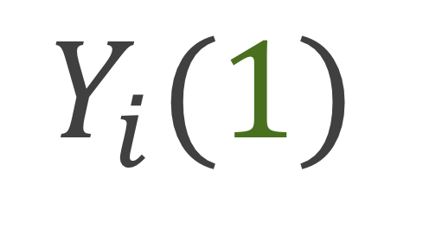
Potential outcomes
$$Y_{i}(0)$$
$$Y_{i}(1)$$
Notes:
If you are assigned the control, we can observe you Y i (0)

Slide 8
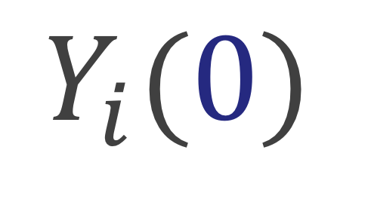
Potential outcomes
$$Y_{i}(0)$$
$$Y_{i}(1)$$
Notes:
And if you are assigned the treatment we can observe your Y i 1. This is often handled fundamentally as a missing data problem. While only one of these paired outcomes is observed, we can estimate what the other, the counterfactual, would have been had the participant received the opposite treatment.

Slide 9
Potential outcomes
$$Y_{i}(0)$$
$$Y_{i}(1)$$
$$−$$
Notes:
Ultimately, we are interested in some estimate of the treatment effect, for example we may want to know what the average treatment effect is across all participants, or we may want to know what the average treatment effect is among participants who received the treatment. I’m going to show you a few of these causal estimands and how we can estimate them using specific weights

Slide 10
Causal Quantities

Slide 11

Average treatment effect
$$E[Y\left(0\right)−Y\left(1\right)]$$

Slide 12

No unmeasured confounders
$$\left(Y\left(0\right),Y\left(1\right)\right)⊥Z|X$$

Slide 13

Propensity score
$$e_{i}=P(Z_{i}=1|X)$$

Slide 14

Average treatment effect
$$w_{ATE}=\frac{Z_{i}}{e_{i}}+\frac{{1 −Z}_{i}}{1 −e_{i}}$$

Slide 16

Average treatment effect among the treated
$$E\left[Y\left(0\right)−Y\left(1\right)\right|Z=1]$$

Slide 17

Average treatment effect among the treated
$$w_{ATT}=\frac{e_{i}Z_{i}}{e_{i}}+\frac{e_{i}\left(1−Z_{i}\right)}{1 −e_{i}}$$

Slide 19

Average treatment effect among the controls
$$E\left[Y\left(0\right)−Y\left(1\right)\right|Z=0]$$

Slide 20

Average treatment effect among the controls
$$w_{ATC}=\frac{\left(1−e_{i}\right)Z_{i}}{e_{i}}+\frac{\left(1−e_{i}\right)\left(1−Z_{i}\right)}{1−e_{i}}$$

Slide 22

Average treatment effect among the evenly matchable
$$E\left[Y\left(0\right)−Y\left(1\right)\right|M_{d}=1]$$

Slide 23

Average treatment effect among the evenly matchable
$$w_{ATM}=\frac{min\left\{e_{i}, 1−e_{i}\right\}}{{e_{i}Z}_{i}+(1 −e_{i})(1−Z_{i})}$$
Minimum of ATT and ATC weights (Samuels 2017)

Slide 25

Average treatment effect among the overlap population
$$w_{ATO}=\left(1−e_{i}\right)Z_{i}+ e_{i}(1−Z_{i})$$

Slide 27
ATE
ATT
ATC
ATM
AT0

Slide 28
ATE
ATT
ATC
ATM
AT0

Slide 29
ATE
ATT
ATC
ATM
AT0

Slide 30
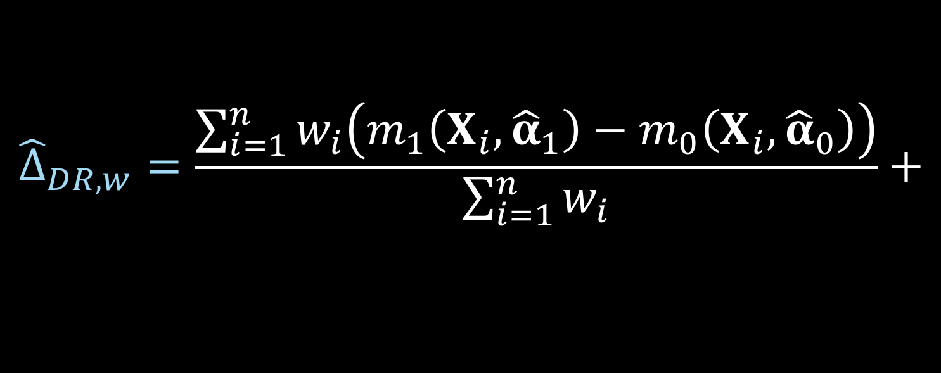


Doubly robust estimator
$${\hat{Δ}}_{DR, w}=\frac{\sum_{i=1}^{n}{w_{i}\left(m_{1}\left(X_{i},{\hat{α}}_{1}\right)−m_{0}\left(X_{i}, {\hat{α}}_{0}\right)\right)}}{\sum_{i=1}^{n}{w_{i}}}+$$
$$\frac{\sum_{i=1}^{n}{w_{i}Z_{i}\left(Y_{i}−m_{1}\left(X_{i}, {\hat{α}}_{1}\right)\right)}}{\sum_{i=1}^{n}{w_{i}}Z_{i}}−$$
$$\frac{\sum_{i=1}^{n}{w_{i}{(1−Z}_{i})\left(Y_{i}−m_{0}\left(X_{i}, {\hat{α}}_{0}\right)\right)}}{\sum_{i=1}^{n}{w_{i}}(1−Z_{i})}$$
Notes:
_click_ these ws are the weights we’ve just defined _click_
_click_ m1 is the predicted y value, calculated using the model built on the treated participants _click_
_click_ and m0 is the predicted y value, calculated using the model built on the participants assigned to the control group

Slide 31
Doubly robust estimator
$${\hat{Δ}}_{DR, w}=\frac{\sum_{i=1}^{n}{w_{i}\left(m_{1}\left(X_{i},{\hat{α}}_{1}\right)−m_{0}\left(X_{i}, {\hat{α}}_{0}\right)\right)}}{\sum_{i=1}^{n}{w_{i}}}+$$
$$\frac{\sum_{i=1}^{n}{w_{i}Z_{i}\left(Y_{i}−m_{1}\left(X_{i}, {\hat{α}}_{1}\right)\right)}}{\sum_{i=1}^{n}{w_{i}}Z_{i}}−$$
$$\frac{\sum_{i=1}^{n}{w_{i}{(1−Z}_{i})\left(Y_{i}−m_{0}\left(X_{i}, {\hat{α}}_{0}\right)\right)}}{\sum_{i=1}^{n}{w_{i}}(1−Z_{i})}$$
Notes:
So basically we’re getting the _click_ difference between the predicted values for the model fit on treated and the predicted values for the model fit on the controls, taking a weighted average _click_, and then we have the _click_ residual between the observed Y and the predicted Y among the treated _click_, and the _click_ observed Y and predicted Y among the controls, so even just looking at the equation as it stands now, we can see that if the outcome model is correctly specified these residuals should essentially be 0 as your sample size increases, and this first part should be the correct estimate of interest. In the next section I’ll walk through how we proved the doubly robust estimator specifically for the overlap case, and there I’ll show how we can rearrange this to prove that it also gives a consistent estimator when the propensity score model is correct and the outcome model is incorrect.

Slide 32
Freedman & Berk Simulation

Slide 33
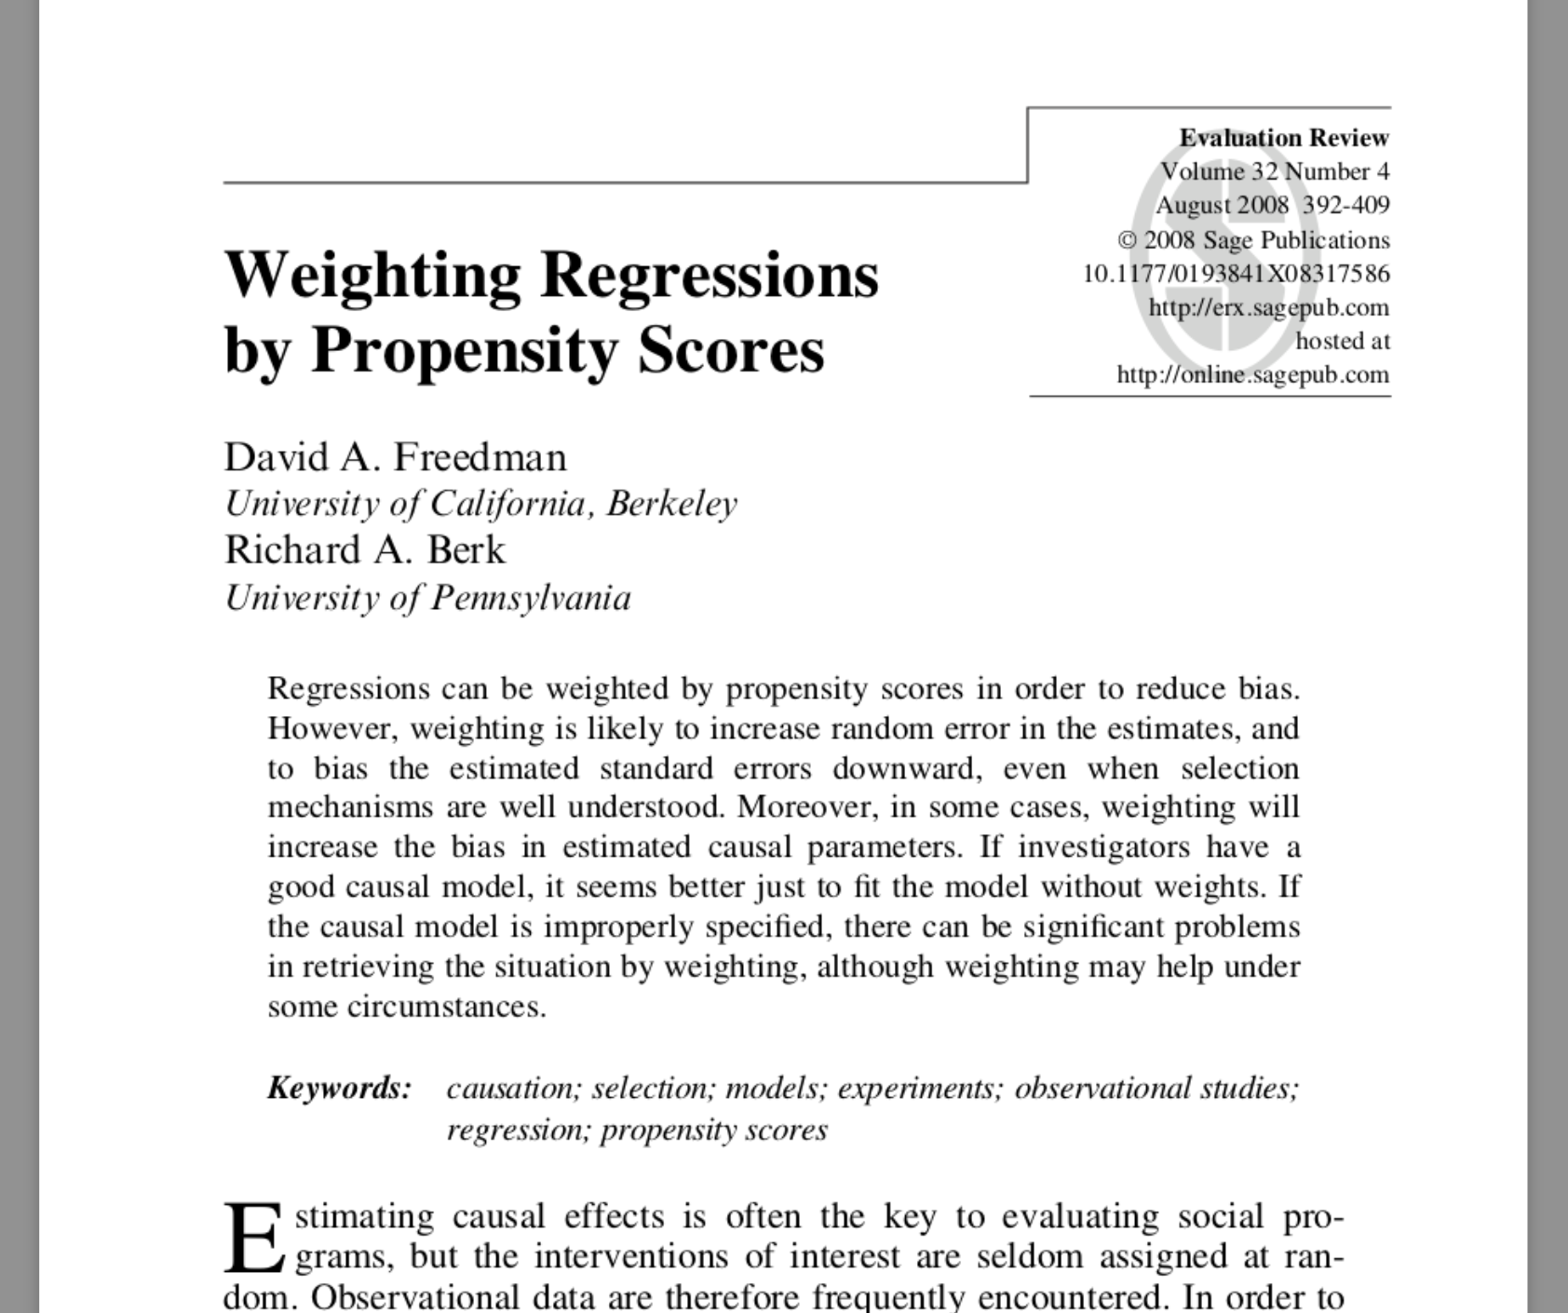

Slide 34
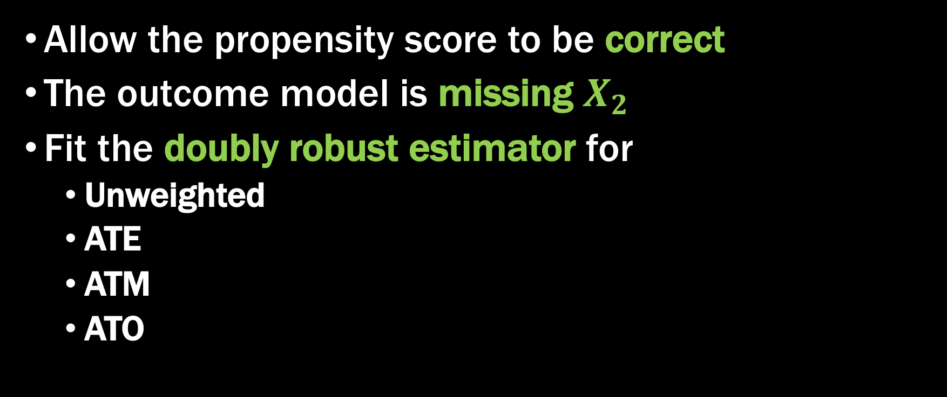
Fit a misspecified model
Allow the propensity score to be correct
The outcome model is missing $X_{2}$
Fit the doubly robust estimator for
Unweighted
ATE
ATM
ATO

Slide 35

Simulation
$$X \sim MVN\left(\left({0.5 \atop 1}\right), \left(\begin{matrix}2 & 1 \\ 1 & 1\end{matrix}\right)\right)$$
$$V \sim N \left(0, 1\right)$$
$$Z=\left\{\begin{aligned}1 0.5+0.25X_{1}+0.75X_{2}+V>0 \\ &0 o.w.\end{aligned}\right.$$
$$U \sim N(0, 1)$$
$$Y=1+Z+X_{1}+2X_{2}+U$$

Slide 39

Simulation
$$X \sim MVN\left(\left({0.5 \atop 1}\right), \left(\begin{matrix}2 & 1 \\ 1 & 1\end{matrix}\right)\right)$$
$$V \sim logit \left(0, 1\right)$$
$$Z=\left\{\begin{aligned}1 0.5+0.25X_{1}+0.75X_{2}+V>0 \\ &0 o.w.\end{aligned}\right.$$
$$U \sim logit(0, 1)$$
$$Y=\left\{\begin{aligned}1 1+Z+X_{1}+2X_{2}+U>0 \\ &0 o.w.\end{aligned}\right.$$

Slide 44

Simulation
$$X \sim MVN\left(\left({0.5 \atop 1}\right), \left(\begin{matrix}2 & 1 \\ 1 & 1\end{matrix}\right)\right)$$
$$V \sim N \left(0, 1\right)$$
$$Z=\left\{\begin{aligned}1 0.5+0.25X_{1}+0.75X_{2}+V>0 \\ &0 o.w.\end{aligned}\right.$$
$$U \sim logit(0, 1)$$
$$Y=\left\{\begin{aligned}1 1+3Z+X_{1}+2X_{2}+U>0 \\ &0 o.w.\end{aligned}\right.$$

Slide 51
Recap
Replicated the finite-sample bias seen by Freedman and Berk using the ATE weights
ATM and ATO weights had improved finite-sample properties
The variance for the ATO and ATM is preferable to that of the ATE

Slide 52
Q&A

Slide 53
Doubly robust and large sample variance estimator for overlap weights

Slide 54

ATO estimator
$$\frac{\sum_{i=1}^{n}{\left(1−e\left(X_{i}, \hat{β}\right)\right)Z_{i}Y_{i}}}{\sum_{i=1}^{n}{\left(1−e\left(X_{i}, \hat{β}\right)\right)Z_{i}}}−\frac{\sum_{i=1}^{n}{e\left(X_{i}, \hat{β}\right){(1−Z}_{i})Y_{i}}}{\sum_{i=1}^{n}{e\left(X_{i}, \hat{β}\right)(1−Z_{i})}}$$

Slide 55
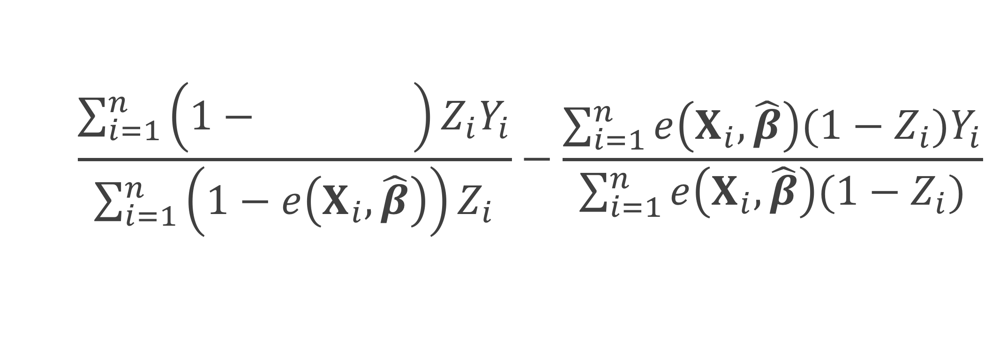
ATO estimator
$$\frac{\sum_{i=1}^{n}{\left(1−e\left(X_{i}, \hat{β}\right)\right)Z_{i}Y_{i}}}{\sum_{i=1}^{n}{\left(1−e\left(X_{i}, \hat{β}\right)\right)Z_{i}}}−\frac{\sum_{i=1}^{n}{e\left(X_{i}, \hat{β}\right){(1−Z}_{i})Y_{i}}}{\sum_{i=1}^{n}{e\left(X_{i}, \hat{β}\right)(1−Z_{i})}}$$
Notes:
Here I represent the fitted propensity score by e(Xi, beta hat) – this is often estimated by fitting a propensity score model using a logistic regression. Xi are the covariate values for participant I, beta hat are the betas obtained from the propensity score model.

Slide 56
ATO estimator
$$\frac{\sum_{i=1}^{n}{\left(1−e\left(X_{i}, \hat{β}\right)\right)Z_{i}Y_{i}}}{\sum_{i=1}^{n}{\left(1−e\left(X_{i}, \hat{β}\right)\right)Z_{i}}}−\frac{\sum_{i=1}^{n}{e\left(X_{i}, \hat{β}\right){(1−Z}_{i})Y_{i}}}{\sum_{i=1}^{n}{e\left(X_{i}, \hat{β}\right)(1−Z_{i})}}$$

Slide 57
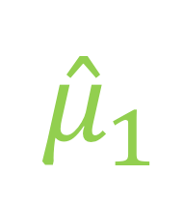
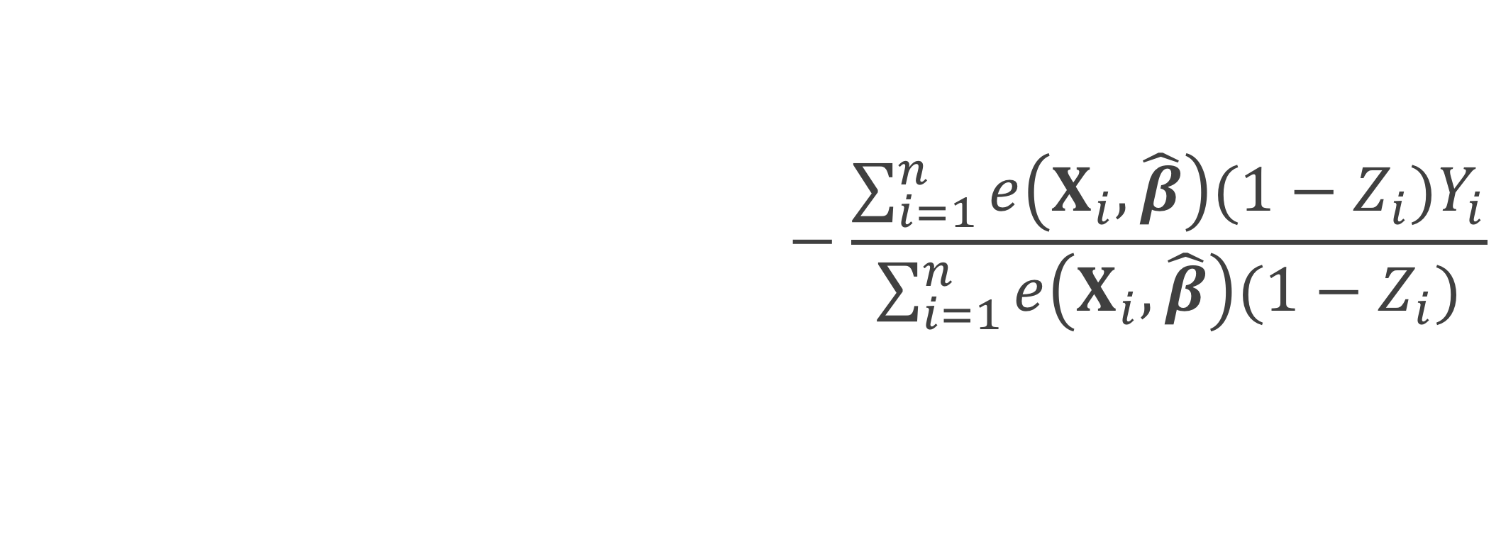
ATO estimator
$$\frac{\sum_{i=1}^{n}{\left(1−e\left(X_{i}, \hat{β}\right)\right)Z_{i}Y_{i}}}{\sum_{i=1}^{n}{\left(1−e\left(X_{i}, \hat{β}\right)\right)Z_{i}}}−\frac{\sum_{i=1}^{n}{e\left(X_{i}, \hat{β}\right){(1−Z}_{i})Y_{i}}}{\sum_{i=1}^{n}{e\left(X_{i}, \hat{β}\right)(1−Z_{i})}}$$
$${\hat{μ}}_{1}$$

Slide 58

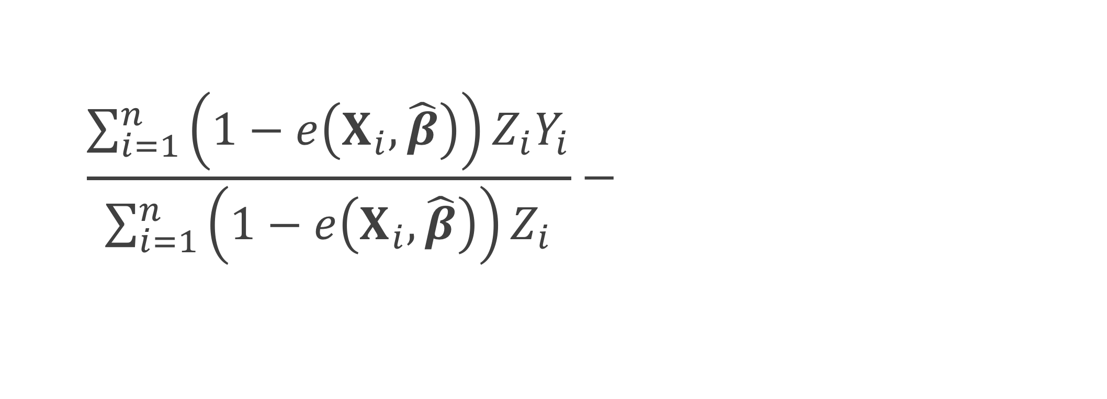

ATO estimator
$$\frac{\sum_{i=1}^{n}{\left(1−e\left(X_{i}, \hat{β}\right)\right)Z_{i}Y_{i}}}{\sum_{i=1}^{n}{\left(1−e\left(X_{i}, \hat{β}\right)\right)Z_{i}}}−\frac{\sum_{i=1}^{n}{e\left(X_{i}, \hat{β}\right){(1−Z}_{i})Y_{i}}}{\sum_{i=1}^{n}{e\left(X_{i}, \hat{β}\right)(1−Z_{i})}}$$
$${\hat{μ}}_{1}$$
$${\hat{μ}}_{0}$$

Slide 59
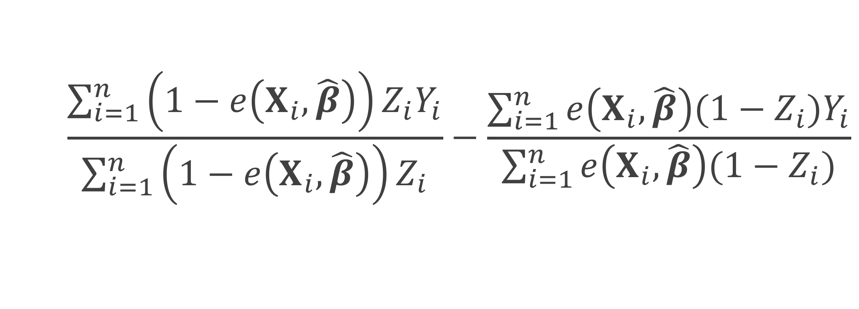

ATO estimator
$$\frac{\sum_{i=1}^{n}{\left(1−e\left(X_{i}, \hat{β}\right)\right)Z_{i}Y_{i}}}{\sum_{i=1}^{n}{\left(1−e\left(X_{i}, \hat{β}\right)\right)Z_{i}}}−\frac{\sum_{i=1}^{n}{e\left(X_{i}, \hat{β}\right){(1−Z}_{i})Y_{i}}}{\sum_{i=1}^{n}{e\left(X_{i}, \hat{β}\right)(1−Z_{i})}}$$
$${\hat{μ}}_{1}$$
$$−$$
$${\hat{μ}}_{0}$$

Slide 60
How to
Plug in
Fit a weighted generalized linear model Y ~ Z

Slide 61
How to
Plug in
Fit a weighted generalized linear model Y ~ Z
But what about the variance?
Pull from the GLM?
Robust standard errors? (sandwich estimator)

Slide 62
Williamson 2013
“
…ignoring the estimation of the propensity score in the calculation of the variance leads to the erroneous conclusion that the IPTW treatment effect estimator has the same variance as an unadjusted estimator; thus, it is important to use a variance estimator that correctly takes into account the estimation of the propensity score.
”

Slide 63


ATO estimator
ATO weight
$$u\left(θ\right)=\left(\begin{matrix}\left(Y−μ_{1}\right)Z\left(1−e\left(X, β\right)\right) \\ \left(Y−μ_{0}\right)\left(1−Z\right)e\left(X, β\right) \\ X\left(Z−e\left(X, β\right)\right)\end{matrix}\right)$$
$$θ={\left(μ_{1}, μ_{0},β^{T}\right)}^{T}$$

Slide 64

Sandwich estimator
$$var\left(θ\right)=A^{−1}BA^{−T}$$

Slide 65

Sandwich estimator
$$var\left(θ\right)=A^{−1}BA^{−T}$$
$$A=−E\left[\frac{∂u\left(θ\right)}{∂θ}\right]$$

Slide 66


$$θ={\left(μ_{1}, μ_{0},β^{T}\right)}^{T}$$
$$u\left(θ\right)=\left(\begin{matrix}\left(Y−μ_{1}\right)Z\left(1−e\left(X, β\right)\right) \\ \left(Y−μ_{0}\right)\left(1−Z\right)e\left(X, β\right) \\ X\left(Z−e\left(X, β\right)\right)\end{matrix}\right)$$
$$A=−E\left[\frac{∂u\left(θ\right)}{∂θ}\right]$$

Slide 67
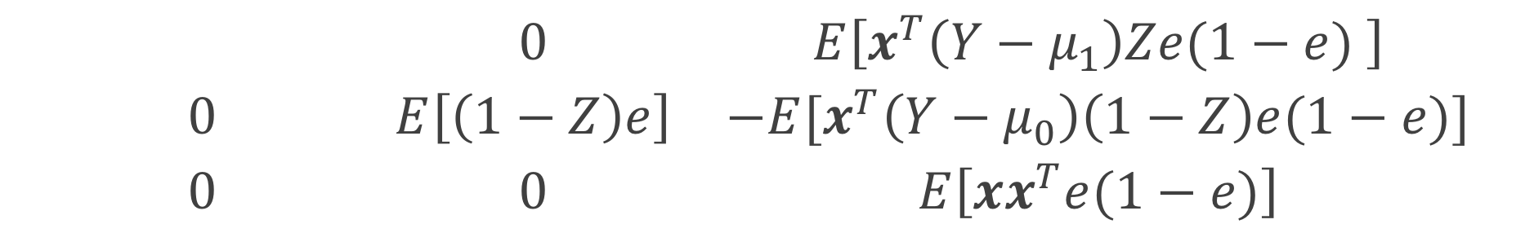
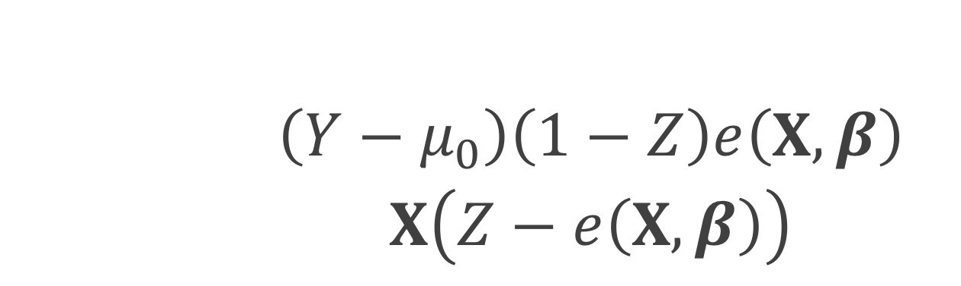
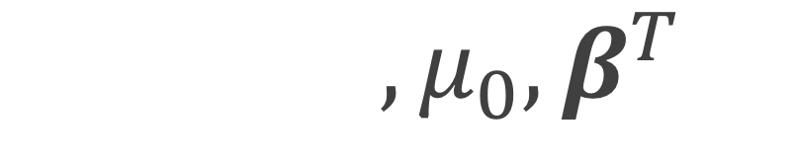
$$θ={\left(μ_{1}, μ_{0},β^{T}\right)}^{T}$$
$$u\left(θ\right)=\left(\begin{matrix}\left(Y−μ_{1}\right)Z\left(1−e\left(X, β\right)\right) \\ \left(Y−μ_{0}\right)\left(1−Z\right)e\left(X, β\right) \\ X\left(Z−e\left(X, β\right)\right)\end{matrix}\right)$$
$$\left(\begin{matrix}E\left[Z(1−e)\right] & 0 & E\left[x^{T}\left(Y−μ_{1}\right)Ze(1−e) \right] \\ 0 & E\left[\left(1−Z\right)e\right] & −E[x^{T}\left(Y−μ_{0}\right)\left(1−Z\right)e(1−e)] \\ 0 & 0 & E\left[{xx}^{T}e(1−e)\right]\end{matrix}\right)$$

Slide 68
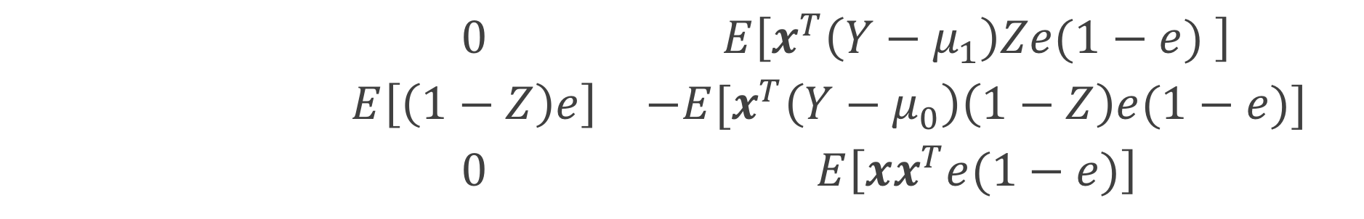
$$θ={\left(μ_{1}, μ_{0},β^{T}\right)}^{T}$$
$$u\left(θ\right)=\left(\begin{matrix}\left(Y−μ_{1}\right)Z\left(1−e\left(X, β\right)\right) \\ \left(Y−μ_{0}\right)\left(1−Z\right)e\left(X, β\right) \\ X\left(Z−e\left(X, β\right)\right)\end{matrix}\right)$$
$$\left(\begin{matrix}E\left[Z(1−e)\right] & 0 & E\left[x^{T}\left(Y−μ_{1}\right)Ze(1−e) \right] \\ 0 & E\left[\left(1−Z\right)e\right] & −E[x^{T}\left(Y−μ_{0}\right)\left(1−Z\right)e(1−e)] \\ 0 & 0 & E\left[{xx}^{T}e(1−e)\right]\end{matrix}\right)$$

Slide 69
$$θ={\left(μ_{1}, μ_{0},β^{T}\right)}^{T}$$
$$u\left(θ\right)=\left(\begin{matrix}\left(Y−μ_{1}\right)Z\left(1−e\left(X, β\right)\right) \\ \left(Y−μ_{0}\right)\left(1−Z\right)e\left(X, β\right) \\ X\left(Z−e\left(X, β\right)\right)\end{matrix}\right)$$
$$\left(\begin{matrix}E\left[Z(1−e)\right] & 0 & E\left[x^{T}\left(Y−μ_{1}\right)Ze(1−e) \right] \\ 0 & E\left[\left(1−Z\right)e\right] & −E[x^{T}\left(Y−μ_{0}\right)\left(1−Z\right)e(1−e)] \\ 0 & 0 & E\left[{xx}^{T}e(1−e)\right]\end{matrix}\right)$$

Slide 70

Sandwich estimator
$$var\left(θ\right)=A^{−1}BA^{−T}$$
$B=E\left[u\left(θ\right)u{\left(θ\right)}^{T}\right]$

Slide 71
Sensitivity to Unmeasured Confounders: A Tipping Point Analysis

Slide 72
Meaningful confounders
1. How imbalanced is the confounder between the exposure groups?
2. How predictive is the confounder of the outcome?

Slide 73
Confounding
Confounder
Exposure
Outcome

Slide 74
Meaningful confounders
1. How imbalanced is the confounder between the exposure groups?
2. How predictive is the confounder of the outcome?

Slide 75
Confounding
Confounder
Exposure
Outcome

Slide 76


Slide 77
Propensity scores
Rosenbaum and Rubin showed in observational studies, conditioning on propensity scores can lead to unbiased estimates of the exposure effect
There are no unmeasured confounders
Every subject has a nonzero probability of receiving either exposure

Slide 78
Propensity scores
Rosenbaum and Rubin showed in observational studies, conditioning on propensity scores can lead to unbiased estimates of the treatment effect
There are no unmeasured confounders
Every subject has a nonzero probability of receiving either treatment

Slide 79
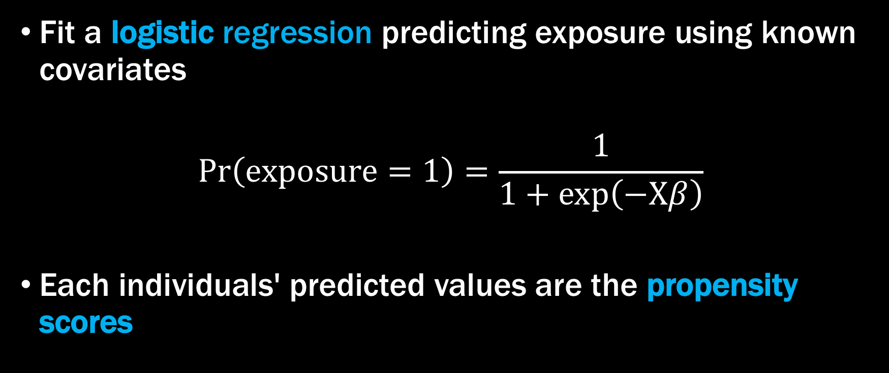
Propensity scores
Fit a logistic regression predicting exposure using known covariates
$$Pr\left(exposure=1\right)=\frac{1}{1+exp\left(−Xβ\right)}$$
Each individuals' predicted values are the propensity scores

Slide 80
Propensity scores
glm(exposure ~ smoker + cowboy_hat + sick . . .,
data = df,
family = binomial)

Slide 81
Propensity scores
glm(exposure ~ smoker + cowboy_hat + sick . . .,
data = df,
family = binomial) %>%
predict()

Slide 82
Propensity scores
glm(exposure ~ smoker + cowboy_hat + sick . . .,
data = df,
family = binomial) %>%
predict()
#> 1 2 3 4 5 #> 0.831823 0.562374 0.942197 2.288641 0.366256

Slide 83
Propensity scores
glm(exposure ~ smoker + cowboy_hat + sick . . .,
data = df,
family = binomial) %>%
predict(type = “response”)

Slide 84
Propensity scores
glm(exposure ~ smoker + cowboy_hat + sick . . .,
data = df,
family = binomial) %>%
predict(type = “response”)
#> 1 2 3 4 5 #> 0.6967404 0.6370019 0.7195434 0.9079320 0.5905542

Slide 85
Propensity scores
p <- glm(exposure ~ smoker + cowboy_hat + sick . . .,
data = df,
family = binomial) %>%
predict(type = “response”)

Slide 86
Propensity scores
0.9
0.2
0.1
0.3
0.7
0.3
0.1
0.6
0.6
0.9
0.2
0.2
0.3
0.1
0.1
0.8
0.7
0.7
0.8
0.2
0.2

Slide 87
Propensity scores
0.9
0.2
0.1
0.3
0.6
0.6
0.9
0.2
0.3
0.1
0.8
0.7
0.7
0.8
0.2
0.2

Slide 88
Propensity scores
0.2
0.2
0.3
0.6
0.7
0.8
0.9
0.1
0.1
0.2
0.2
0.3
0.6
0.7
0.8
0.9

Slide 89
Propensity Scores
Weighting
Matching
Stratification
Direct Adjustment
…

Slide 90
Propensity Scores
Weighting
Matching
Stratification
Direct Adjustment
…

Slide 91

Weighting
$$w_{ATM}=\frac{\min{\{p_{i}, 1−p_{i}\}}}{Z_{i}p_{i}+(1−Z_{i})(1−p_{i})}$$

Slide 92
Weighting
p_0 <- 1 - p
df$weight <- pmin(p, p_0) /
ifelse(exposure == 1, p, p_0)

Slide 93
Imbalance between exposures
0.2
0.2
0.3
0.6
0.7
0.8
0.9
0.1
0.1
0.2
0.2
0.3
0.6
0.7
0.8
0.9

Slide 94
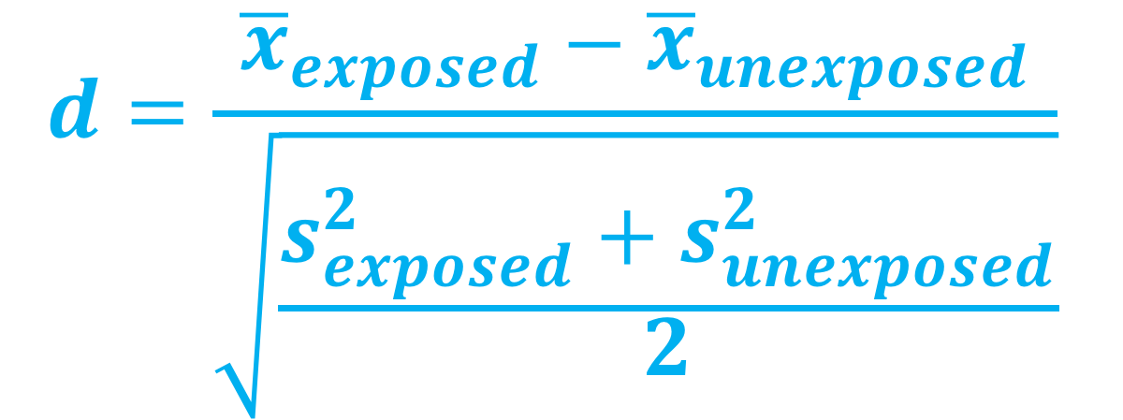
Standardized mean difference
$$d=\frac{{\overline{x}}_{exposed}−{\overline{x}}_{unexposed}}{\sqrt{\frac{s_{exposed}^{2}+s_{unexposed}^{2}}{2}}}$$

Slide 95
Standardized Mean Difference
library(survey)
svy_des <- svydesign(
ids = ~ 1,
data = df,
weights = ~ weight)

Slide 96
Standardized Mean Difference
library(tableone)
smd_table <- svyCreateTableOne(
vars = c(“smoker”, “cowboy_hat”, “sick”, . . .),
strata = “exposure”,
data = svy_des,
test = FALSE)
print(smd_table, smd = TRUE)

Slide 97
Standardized Mean Difference
 | Exposed | Unexposed | SMD
n | 1897.07 | 1900.24
mustache | 60.71 (16.95) | 60.90 (15.61) | 0.012
cowboy hat | 204.59 (101.45) | 202.90 (106.44) | 0.016
glasses | 70.77 (27.00) | 70.51 (27.50) | 0.01
smoker | 37.46 (10.93) | 37.40 (11.28) | 0.005
crazy hair | 2.27 (2.46) | 2.27 (1.82) | 0.003
smile | 2.49 (5.48) | 2.47 (4.80) | 0.003
sick | 30.92 (8.23) | 30.95 (7.54) | 0.003
harry potter | 3.04 (0.69) | 3.03 (0.93) | 0.01
healthy | 145.4 (7.7) | 152.2 (8.0) | 0.013

Slide 98
Standardized Mean Difference
library(tableone)
smd_table_unweighted <- CreateTableOne(
vars = c(“smoker”, “cowboy_hat”, “sick”, . . .),
strata = “exposure”,
data = df,
test = FALSE)
print(smd_table_unweighted, smd = TRUE)

Slide 99
Love Plots

Slide 100
Imbalance between exposures
Love Plots

Slide 101
Standardized Mean Difference
library(tidyr)
plot_df <- data.frame(
var = names(ExtractSmd(smd_table)),
Unadjusted = ExtractSmd(smd_table_unweighted ),
Weighted = ExtractSmd(smd_table)) %>%
gather("Method", "SMD", -var)

Slide 102
Standardized Mean Difference
library(ggplot2)
ggplot(
data = plot_df,
mapping = aes(x = var, y = SMD, group = Method, color = Method)
) +
geom_line() +
geom_point() +
geom_hline(yintercept = 0.1, color = "black", size = 0.1) +
coord_flip()

Slide 103
Love Plots

Slide 104
Outcome model
svyglm(
outcome ~ exposure,
data = svy_des,
family = binomial)

Slide 105
Outcome model
svyglm(
outcome ~ exposure,
data = svy_des,
family = binomial) %>%
confint(parm = “exposure”)

Slide 106
Outcome model
svyglm(
outcome ~ exposure,
data = svy_des,
family = binomial) %>%
confint(parm = “exposure”) %>%
exp()
#> 2.5% 97.5%
#> exposure 1.51 2.01

Slide 107
unmeasured confounding

Slide 108
All you need
Exposure-outcome effect
Exposure-unmeasured confounder effect
Outcome-unmeasured confounder effect

Slide 109
All you need
Exposure-outcome effect generally estimated from a model, for example an odds ratio, hazard ratio, or risk ratio
Exposure-unmeasured confounder effect
Outcome-unmeasured confounder effect
Odds Ratio Confidence Interval: (1.5, 2)

Slide 110
All you need
Exposure-outcome effect generally estimated from a model, for example an odds ratio, hazard ratio, or risk ratio
Exposure-unmeasured confounder effect
Outcome-unmeasured confounder effect

Slide 111

Tipping point analyses
what will tip our confidence bound to cross 1

Slide 112
All you need
Exposure-outcome effect generally estimated from a model, for example an odds ratio, hazard ratio, or risk ratio
Exposure-unmeasured confounder effect can use my observed variables to estimate this
Outcome-unmeasured confounder effect

Slide 113
All you need
Exposure-outcome effect generally estimated from a model, for example an odds ratio, hazard ratio, or risk ratio
Exposure-unmeasured confounder effect can use my observed variables to estimate this
Outcome-unmeasured confounder effect

Slide 114
Exposure-unmeasured confounder effect
Prevalence of the unmeasured confounder among the exposed
Prevalence of the unmeasured confounder among the unexposed

Slide 115
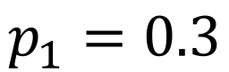
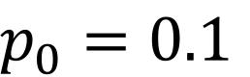
$p_{0}=0.1$
$$p_{1}=0.3$$
Love Plots

Slide 116
Confounding
Confounder
$p_{0}=0.1$
?
$$p_{1}=0.3$$
Exposure
Outcome
Odds Ratio Confidence Interval: (1.5, 2)

Slide 117
Standardized Mean Difference
library(tipr)
tip_with_binary(
p0 = 0.1,
p1 = 0.3,
lb = 1.5,
ub = 2)

Slide 118
Standardized Mean Difference
library(tipr)
tip_with_binary(
p0 = 0.1,
p1 = 0.3,
lb = 1.5,
ub = 2)
#> [1] 4.333333

